Slide 1
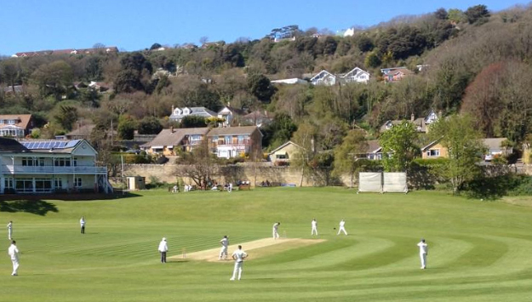
Ventnor Cricket Club
Friday 14th February 2020
Ventnor u12s Gold v Shanklin u12s
Rew Valley Sports Centre
7.30pm meet
Ventnor Gold Team
1. Alfie Toulson
2. Joseph Hill
3. Jess Glover
4. Oliver Cheeseman (*)
5. Nathaniel Wells
6. Stan Smith (+)
7. James Curtis
8. Alfie Cheeseman

