Slide 1
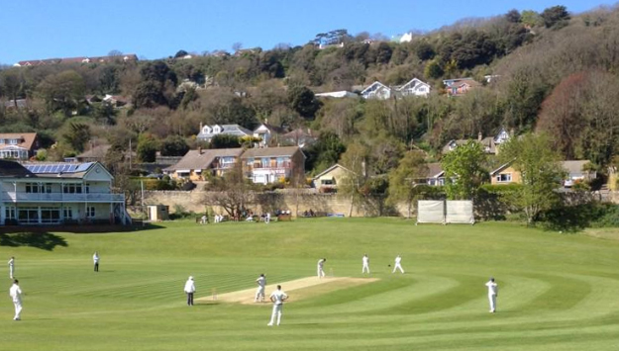
Ventnor Cricket Club
Friday 10th January 2020
East Cowes u12s v Ventnor Gold u12s
Rew Valley Sports Centre
6.40pm meet
Team
1. Oliver Cheeseman
2. Thomas Southcott
3. Jess Glover
4. Sam Mills (*)
5. Stan Smith
6. Nathaniel Wells (+)

